Slide 1
MCA Final Year Project (Review II) Evyvahaar
Submitted to the Presidency University, Bengaluru in partial fulfillment for the award of the degree of Master of Computer Applications(MCA)
Project Number : MCA_PR219
Under the supervision of
Mr.S Sakthi Assistant Professor, CSE & IS Presidency University
Name | Roll Number
Suraj AU | 20232MCA0181

Slide 2
Content
Problem Statement
Screenshots
Github Link

Slide 3
Problem Statement
Manual Process – Invoices require manual downloads and sharing, causing delays and errors.
Tracking Issues – No real-time tracking of invoice delivery or acknowledgment.
Payment Delays – Lack of automated reminders results in overdue payments.
Limited Features – Existing systems lack customization and follow-up automation.
Need for Integration – Automating email invoicing improves efficiency and communication.

Slide 4
Module Design
Module 1: Invoice Generation
Creates invoices with customer, product, and tax details.
Generates unique invoice numbers and allows customization.
Module 2: Email Integration
Sends invoices via SMTP or API-based email services.
Supports custom email templates and automated reminders.
Tracks delivery, read receipts, and logs interactions.

Slide 5
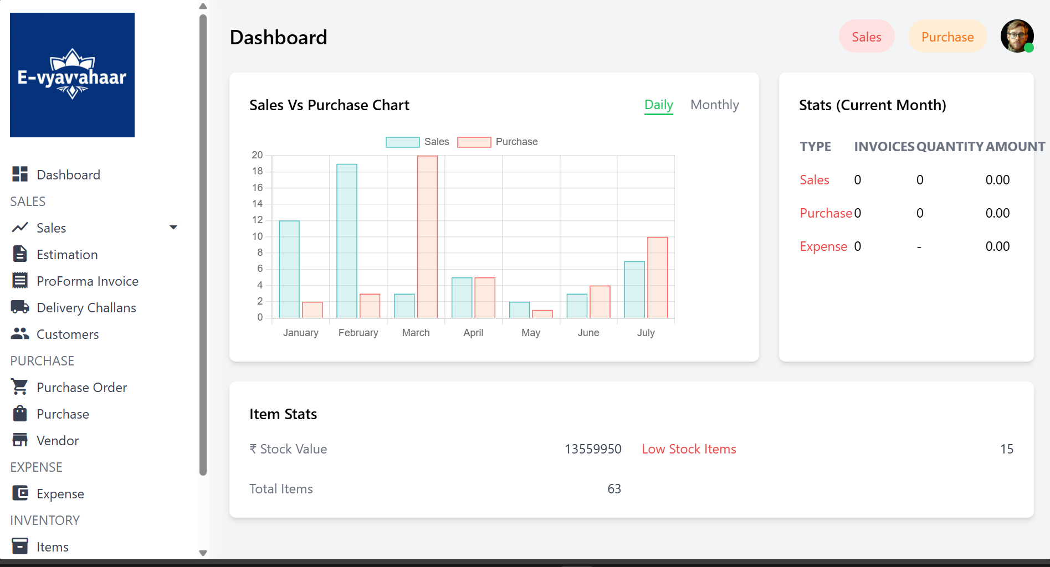

Slide 6
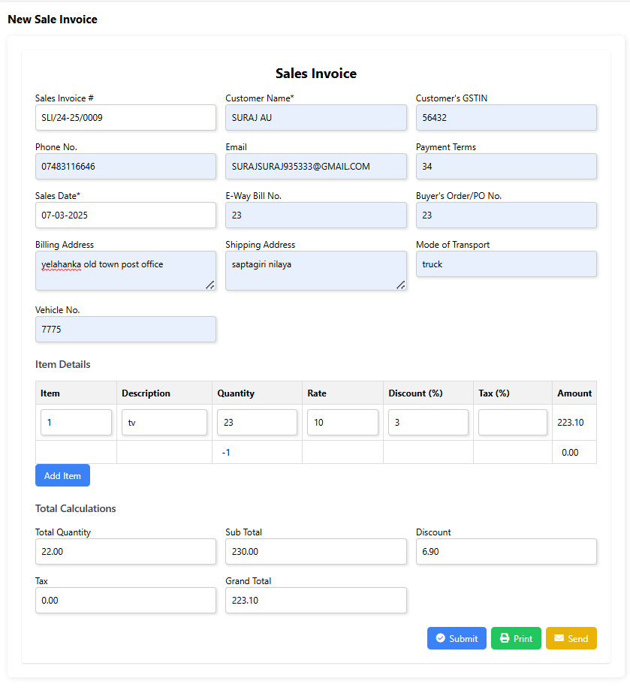

Slide 7
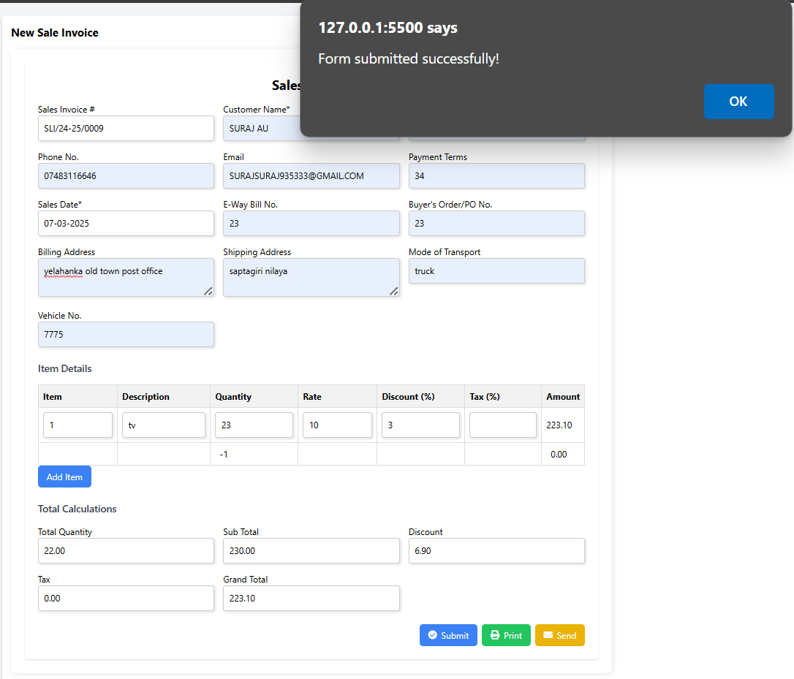

Slide 8
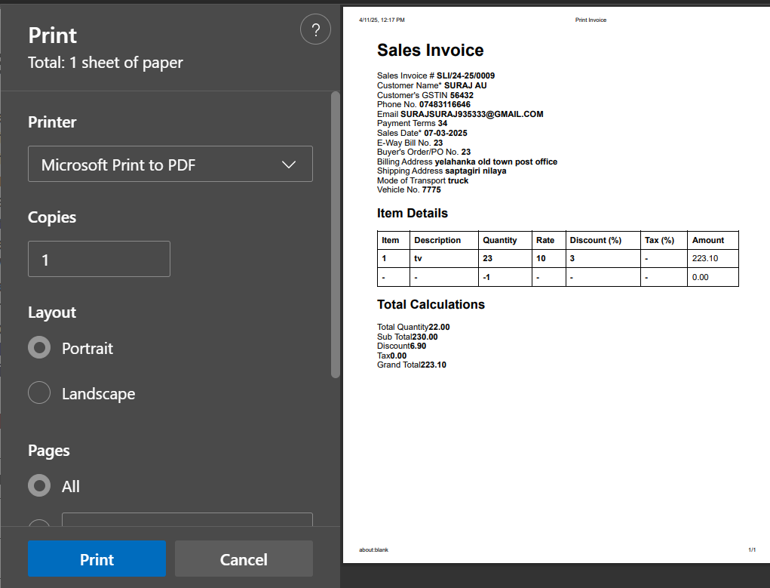

Slide 9
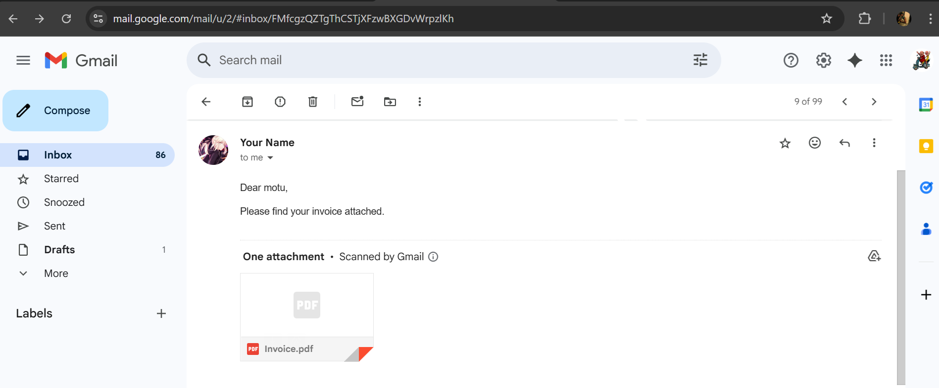

Slide 10
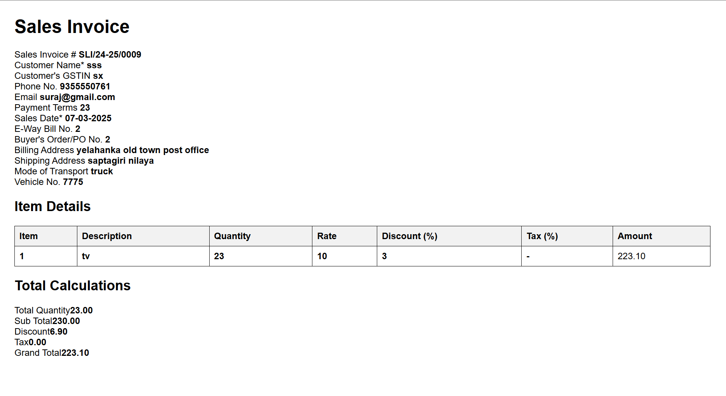

Slide 11
Github Link
Github Link
https://github.com/GamingTyson/evyavahar

Slide 12


